Slide 1

Music Genre Classification
Sherin Ahmad

Slide 2
Agenda
Problem Definition
Overview of Dataset
Technical Explanation
Exploratory Data Analysis
Data Preprocessing
Model Building and Evaluation
Solution

Slide 3
PROBLEM DEFINITION
The main aim of this problem statement is to predict Genre of the track. This problem comes under supervised Machine Learning Classification.

Slide 4
Overview of Dataset
Data Description
Features
Target
This classic dataset contains the Genre of the track and other attributes of almost 14,000 tracks. It's a great dataset to work with data analysis and visualization.
artist: Name of the Artist.
song: Name of the Track.
popularity: popular the song.
danceability: how suitable a track is for dancing
energy: measure of intensity and activity.
key: The key of the track .
loudness: loudness of a track in decibels (dB).
mode: Mode (major or minor) of a track.
speechiness: presence of spoken words in a track.
acousticness: A confidence measure of the track.
instrumentalness: Predicts a track contains no vocals.
liveness: Higher liveness values represent an increased probability that the track was performed live.
Class Genre of the track
valence: describing the musical positiveness
tempo: the speed or pace of a given piece and derives directly from the average beat duration.
duration in milliseconds :Time of the song
time_signature : how many beats (pulses).

Slide 5
Exploratory Data Analysis
Exploratory Data Analysis is one of the important steps in the data analysis process.
Here, the focus is on making sense of the data in hand — things like formulating the correct questions to ask to your data set, how to manipulate the data sources to get the required answers, and others

Slide 6
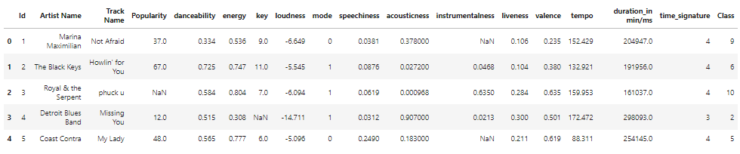
Basic data exploration
head
Notes:
head() : This helps to see a few sample rows of the data
info() : This provides the summarized information of the data
describe() : This provides the descriptive statistical details of the data
nunique(): This helps us to identify if a column is categorical or continuous
---------------------------------------------------------------------------------------
price: Continuous.
carat: Continuous.
cut: Categorical.
color: Categorical.
clarity: Categorical.
depth: Continuous.
table: Continuous.
x: Continuous.
y: Continuous.
z: Continuous.
---------------------------------------------------------------------------------------
we can see from our data:
Target Variable: price
Features: id, carat, cut, color, clarity, depth, table, x, y, z.
---------------------------------------------------------------------------------------
Price: price of a diamond, and is a numerical variable, based on that we can understand that we need to create a supervised ML Regression model, as the target variable is Continuous.
Carat: represents the weight of the diamond, and is a numerical variable.
Cut: represents the quality of the cut of the diamond, and falls into 5 categories: fair, good, very good, ideal, and premium. In these categories were represented by an ordinal variable, 1-5.
Color represents the color of the diamond, and is rated D through J, with D being the most colorless (and valuable) and J being the most yellow. In these categories were represented by an ordinal variable.
Clarity: represents the internal purity of the diamond, and falls into 8 categories: I1, SI2, SI1, VS2, VS1, VVS2, VVS1, and IF (in order from least to purest). In these categories were represented by an ordinal variable, 1-8.
Depth: represents the depth percentage of the diamond, and is a numerical variable.
Table: represents the width of top of diamond relative to widest point, and is a numerical variable.
X: represents the length of the diamond, and is a numerical variable.
Y: represents the width of the diamond, and is a numerical variable.
Z: represents the depth of the diamond, and is a numerical variable.
---------------------------------------------------------------------------------------
we can see the Min. Values of X, Y and Z. It can't be possible..!!
It doesn't make any sense to have either of Length or Width or Height to be zero.

Slide 7
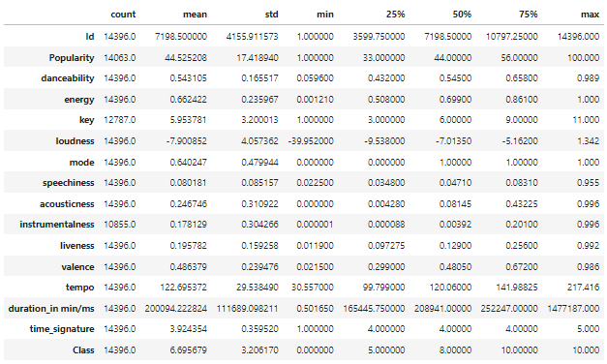
describe

Slide 8
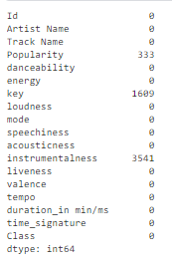
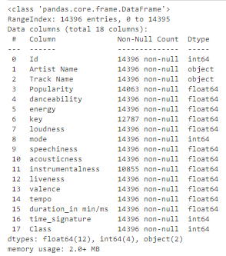
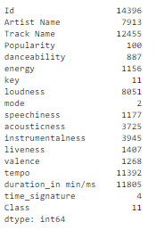
info
nunique
isnull().sum()
duplicated().sum()

Slide 9
Categorical variables:
Artist Name
['Marina Maximilian', 'The Black Keys', 'Royal & the Serpent', ..., 'Cold Years', 'The Jaded Hearts Club', 'Freddy Fender']
Track Name
['Not Afraid', "Howlin' for You", 'phuck u', ..., 'Too Far Gone', "Reach Out I'll Be There", 'Before the Next Teardrop Falls']
Numerical variables:
Id
Popularity
danceability
energy
key
loudness
mode
Speechiness
Acousticness
instrumentalness
iveness
valence
tempo
duration_in min/ms
time_signature

Slide 10
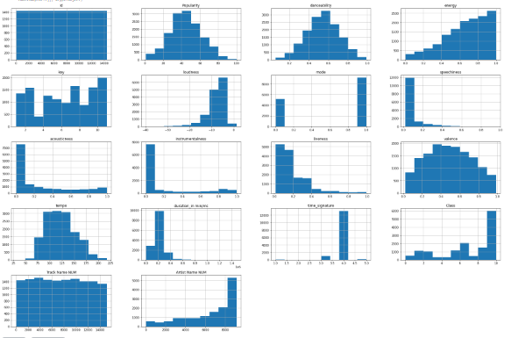
Visual Exploratory
Visualize distribution of all the Continuous Predictor variables in the data using histograms
Notes:
carat : Selected. The distribution is good.
table: Selected. The distribution is good.
depth: Selected. The distribution is good.
x: Selected. Outliers seen near 0, need to treat them.
y: Selected. Outliers seen beyond 20, need to treat them.
z: Selected. Outliers seen beyond 10, need to treat them.

Slide 11
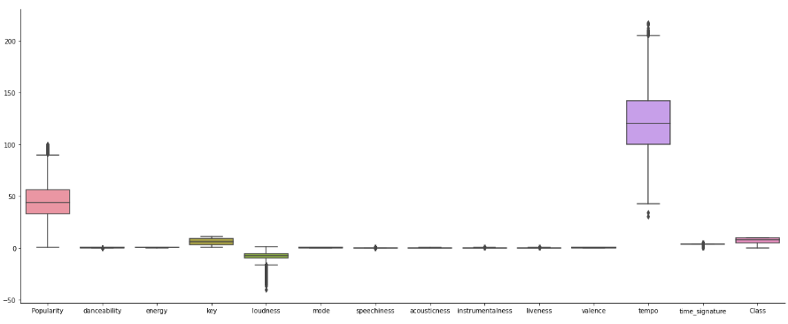
Let’s have a sense of all features with respect to target (class) variable by using box plots

Slide 12
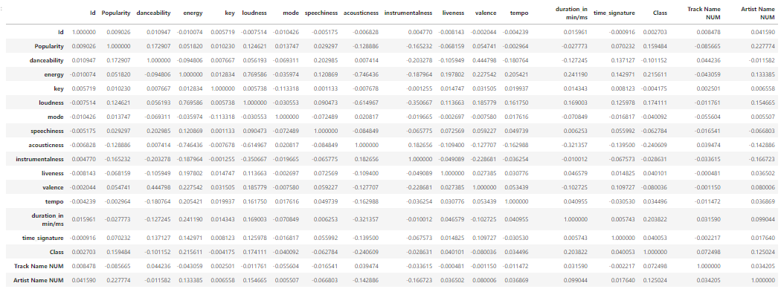
let's quantify that correlation by using .corr()

Slide 13
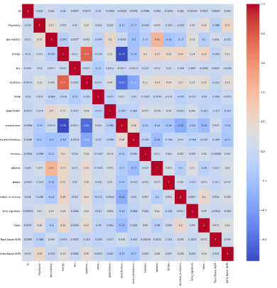
visualize the same using sns.heatmap() method
Notes:
We can conclude that carat, x, y & z features have strong correlation with price variable and Id has very weak relation with price variable.

Slide 14
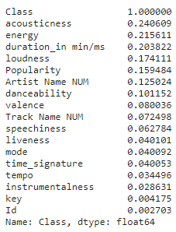
Let’s sort values with absolute correlation with target

Slide 15
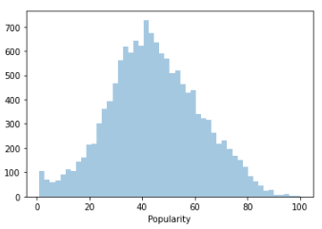
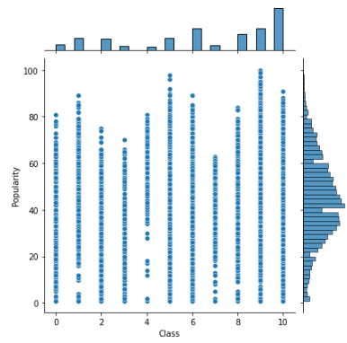
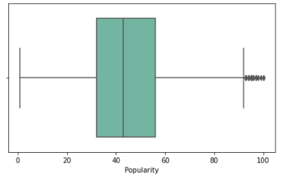
Visualization every feature
Popularity

Slide 16
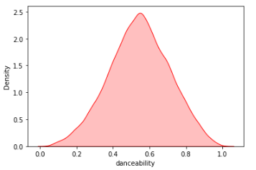
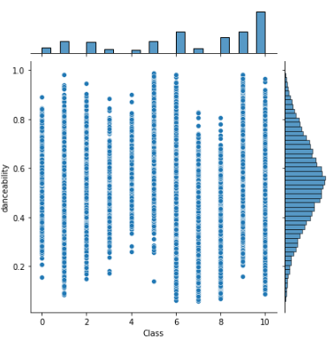
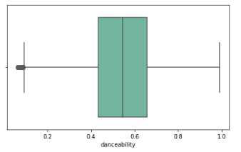
danceability

Slide 17
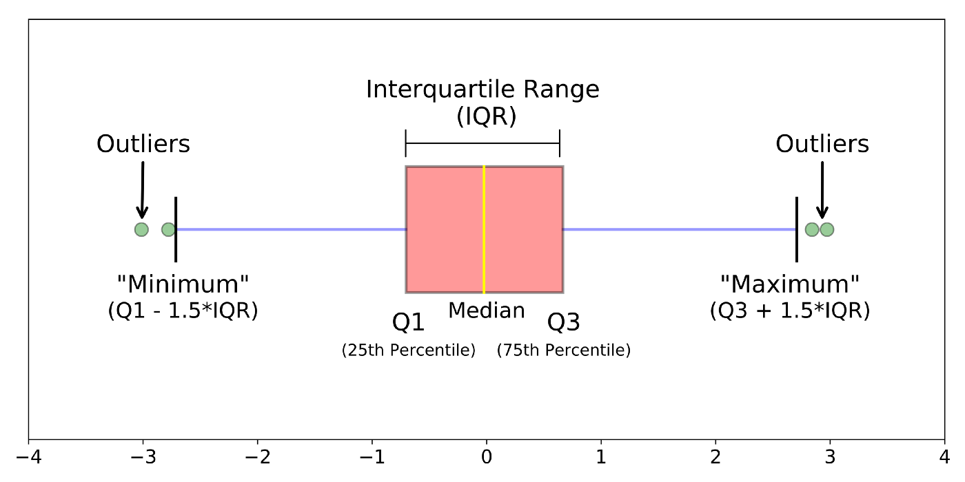
Data preprocessing
Before we begin to building the model
Encoder: it is good to convert the categorical data(train, test) to numerical data, so I use OrdinalEncoder to encoder categorical Artist Name column because the values have ordinal
Artist Name: most -> less
And use LabelEncoder to encoder categorical track name
Missing value:
Fill all missing value by min value
Feature engineering
drop id, kay, class
Outliers all feature by interquartile range
Scaling: StandardScaler on features
Split train and test :
X_train, X_test, y_train, y_test = train_test_split(x,y, test_size=0.2, random_state=42)
Notes:
fit_transform on train and transform on test

Slide 18
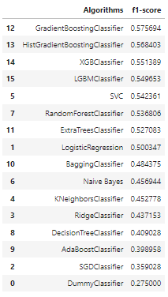
Model Building and Evaluation
Evaluation Metric The evaluation metric for this competition is Root Mean Squared Error (F1-score). The F1-score can be interpreted as a harmonic mean of the precision and recall.
F1 = 2 * (precision * recall) / (precision + recall)

Slide 19
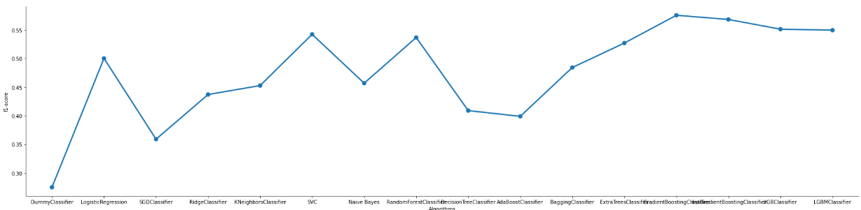

Slide 20
cross_val_score
GradientBoostingClassifier
scores: [0.58420139 0.55927052 0.57359965 0.56969171 0.56708641]
Mean: 0.5707699347469484
XGBRegressor
scores: [0.54166667 0.53538862 0.54146765 0.54971776 0.540165 ]
Mean: 0.5416811405413229
HistGradientBoostingClassifier
scores: [0.55034722 0.52887538 0.55536257 0.54580981 0.55058619]
Mean: 0.5461962355864332
LGBMClassifier
scores: [0.55772569 0.54407295 0.56448111 0.55102041 0.55579679]
Mean: 0.5546193898658756
Notes:
Notice that Randomforest and XGBRegressor lower error, so I built GridSearchCV for both

Slide 21
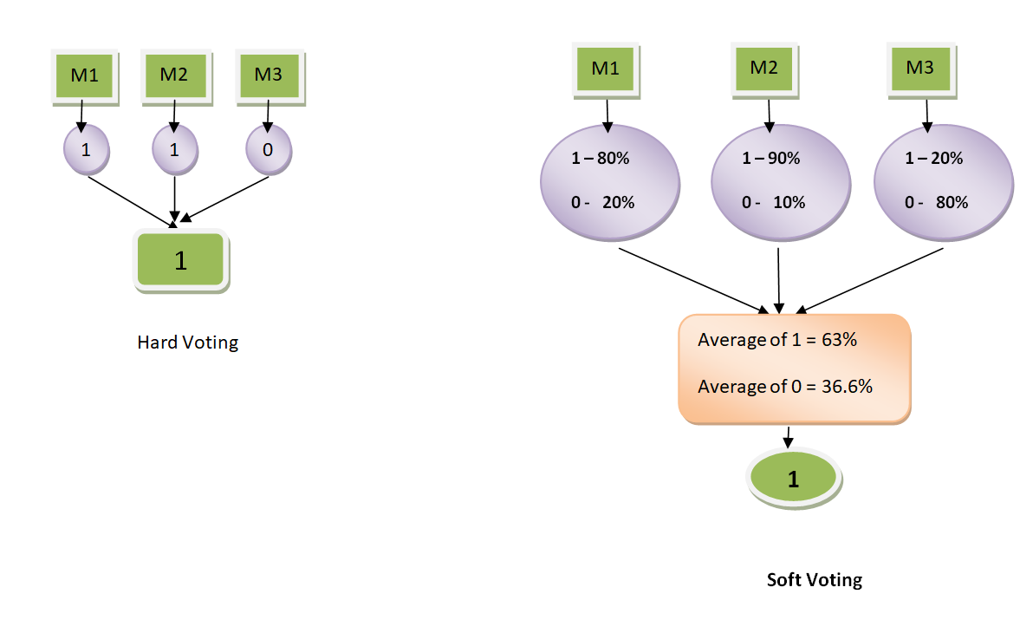
Voting Classifiers

Slide 22
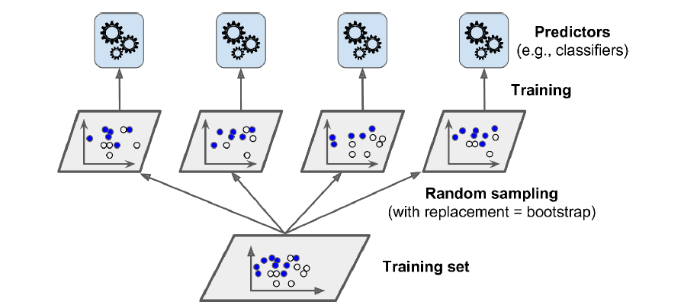
Bagging and Pasting

Slide 23
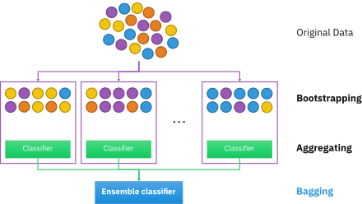
Out-of-Bag

Slide 24
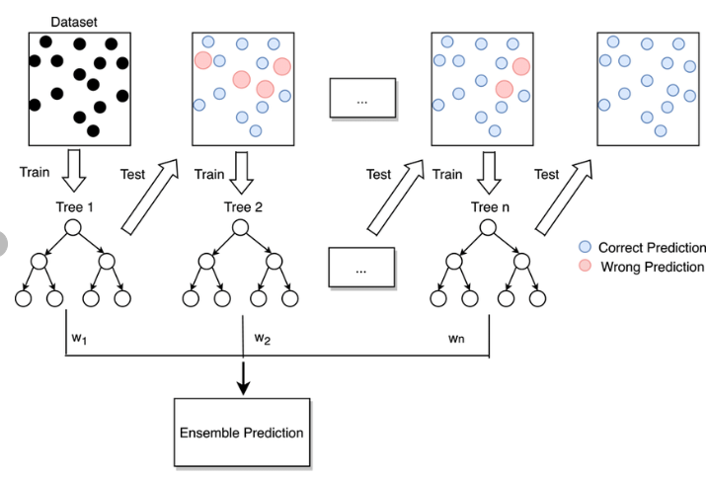
Boosting

Slide 25
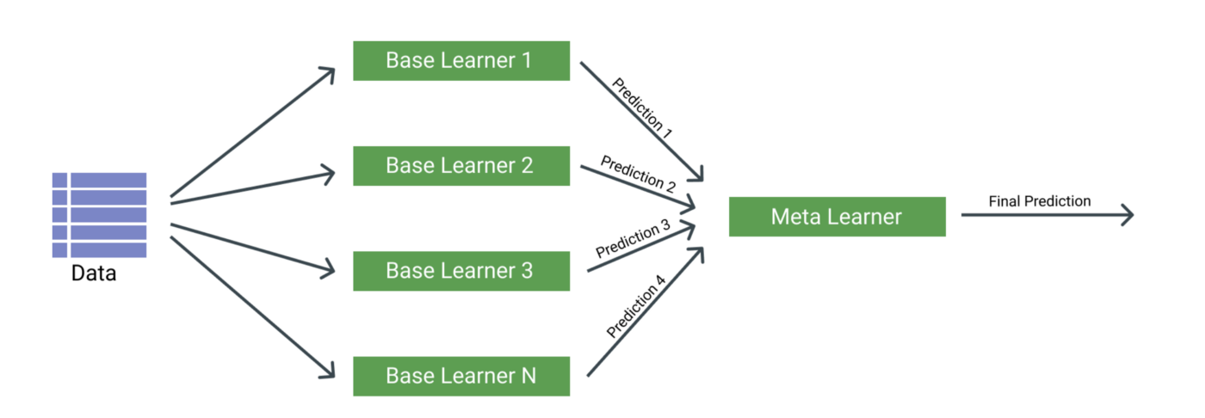
Stacking

Slide 26
Fine tuning
LGBMClassifier
GradientBoostingClassifier
parameters = {'learning_rate': [0.01,0.05,0.1],
'subsample' : [0.9, 0.5, 0.2],
'n_estimators' : [100,500,1000],
'max_depth' : [4,6,8]
}
param_grid = {
'num_leaves': [31, 127],
'reg_alpha': [0.1, 0.5],
'min_data_in_leaf': [30, 50, 100, 300, 400],
'lambda_l1': [0, 1, 1.5],
'lambda_l2': [0, 1]
}

Slide 27
Finally
GradientBoostingClassifier(learning_rate=0.01, max_depth=4, n_estimators=800,subsample=0.6)
F1-score on test = 0.5788194444444444

Slide 28
Choose GradientBoostingClassifier model with best parameter and train on all data, then predict test data and submission
f1-score on puplic data = 0.57539 score
f1-score on private data = 0.57777 score

Slide 29
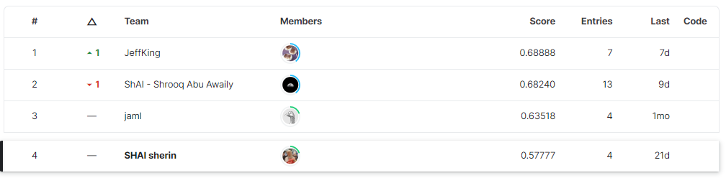

Slide 30
THANKS
Any questions

